Slide 1
Absolute Value Inequalities Day 1

Slide 2
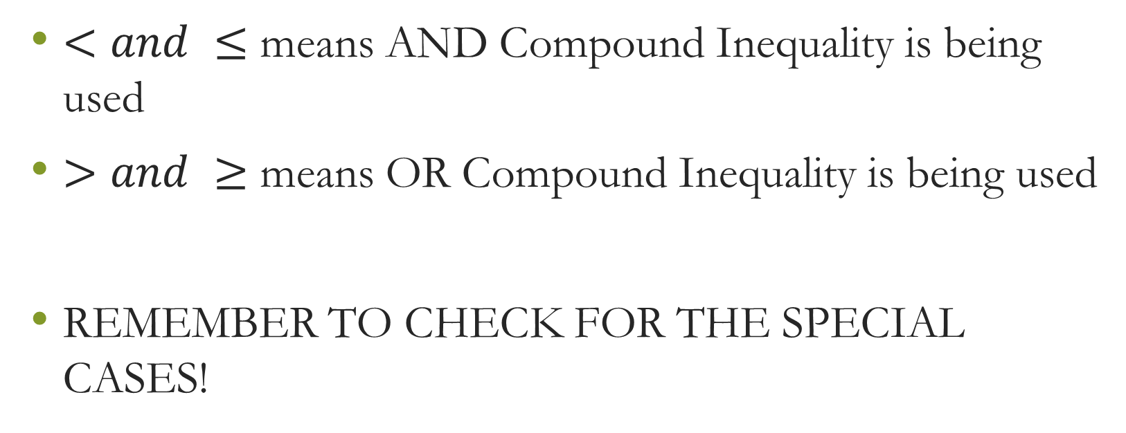
Know what the signs mean!
$<and ≤$ means AND Compound Inequality is being used
$>and ≥$ means OR Compound Inequality is being used
REMEMBER TO CHECK FOR THE SPECIAL CASES!

Slide 3

Example 1: Solve and Graph
$$|p+3|<6$$

Slide 4

Example 2: Solve and Graph
$$\left|\frac{a}{5}\right|<1$$

Slide 5

Example 3: Solve and Graph
$$\left|6+4r\right|<−22$$

Slide 6

Example 4: Solve and Graph
$$|3−9n|≤33$$

Slide 7

Example 5: Solve and Graph
$$\left|−6+n\right|−2<8$$

Slide 8

Example 6: Solve and Graph
$$8|v+10|≤48$$

Slide 9

Example 7: Solve and Graph
$$10+5|n+7|≤65$$

Slide 10

Example 8: Solve and Graph
$$4+6\left|4x+3\right|≤−2$$

Slide 11
Absolute Value Inequalities Day 2

Slide 12
Know what the signs mean!
$<and ≤$ means AND Compound Inequality is being used
$>and ≥$ means OR Compound Inequality is being used
REMEMBER TO CHECK FOR THE SPECIAL CASES!

Slide 13

Example 1: Solve and Graph
$$|−5n|≥45$$

Slide 14

Example 2: Solve and Graph
$$\left|a+7\right|>−4$$

Slide 15

Example 3: Solve and Graph
$$\left|−10x+7\right|>27$$

Slide 16

Example 4: Solve and Graph
$$\left|\frac{n}{5}\right|−10≥9$$

Slide 17

Example 5: Solve and Graph
$$\frac{|r+7|}{8}≥4$$

Slide 18

Example 6: Solve and Graph
$$9\left|7−3m\right|−4>14$$

Slide 19

Example 7: Solve and Graph
$$9\left|4m+3\right|−6>−51$$

